Slide 1
AMAZON SALES DATA ANALYSIS
By MILI BHOWMIK

Slide 2
Problem Statement:
Sales management has gained importance to meet increasing competition and the need for improved methods of distribution to reduce cost and to increase profits.Sales management today is the most important function in a commercial and business enterprise.

Slide 3
Importance of sales managements in Today’s Competitive Environment
Sales management is crucial in today's competitive landscape for meeting customer expectations, maximizing revenue, building brand loyalty, achieving competitive advantage, driving business growth, optimizing resource allocation, enhancing efficiency, and adapting to market changes swiftly. It ensures businesses thrive amidst fierce competition, sustaining profitability and growth.

Slide 4
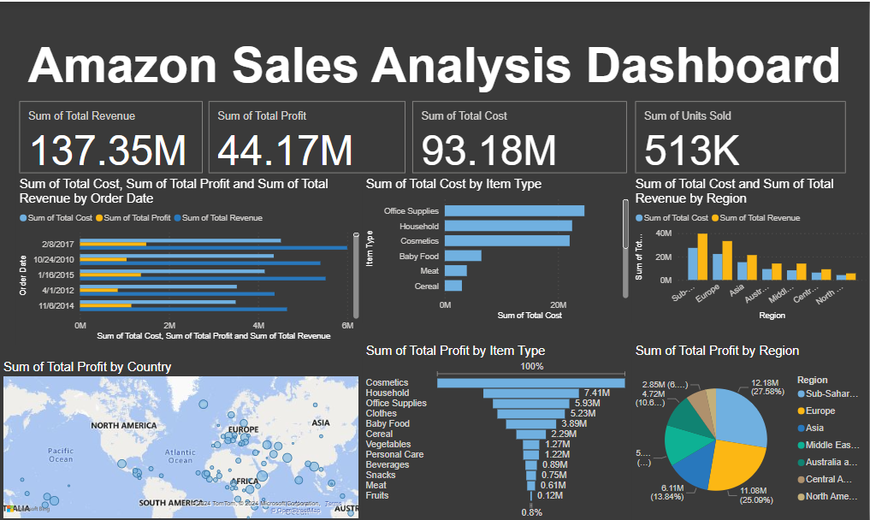

Slide 5
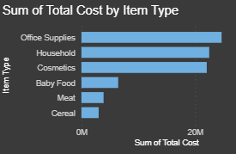
This chart show the cost as per Items type and
Here the office Supplies are more costlier for the company and this type of items has less demand in the market and return more loss.

Slide 6
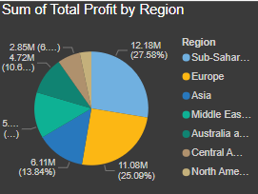
This chart indicate the profit as per different region
More area means profit from the region in high.For example profit from sub-Saharan Africa is highest
Small area means vice-versa.For example profit from North America is lowest here.

Slide 7
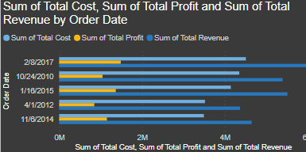
This chart indicate the profit,cost and revenue as per the Order Date
Here it shows that in the year 2017 the profit,cost and revenue is increased with controlled costs typically indicate profitability.

Slide 8
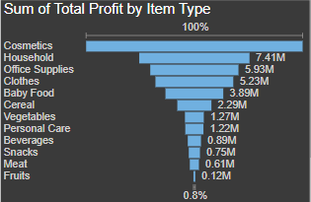
This chart show the profit as per Items type and
Here the Cosmetics are more profit for the company and this type of items has more demand in the market and return more profit.

Slide 9
Conclusion
Overall, the data suggest a healthy demand for certain product sizes and categories ,efficient order processing,and a concentration of sales in specific geographic regions.This analysis could be used to further optimize inventory,enhance customer targeting , and improve logistical operations

Slide 10
Thank you

